Slide 1
Eye-Tracking Experiment
1
Experiment Set-Up

Slide 2
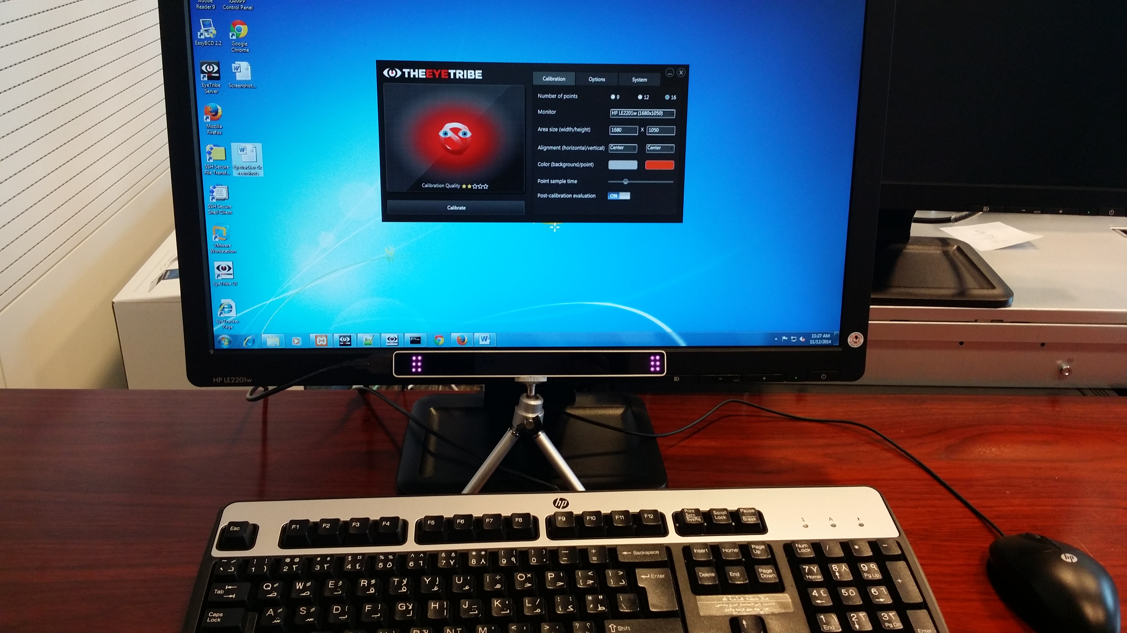
Equipment: Computer & eyetracker

Slide 3
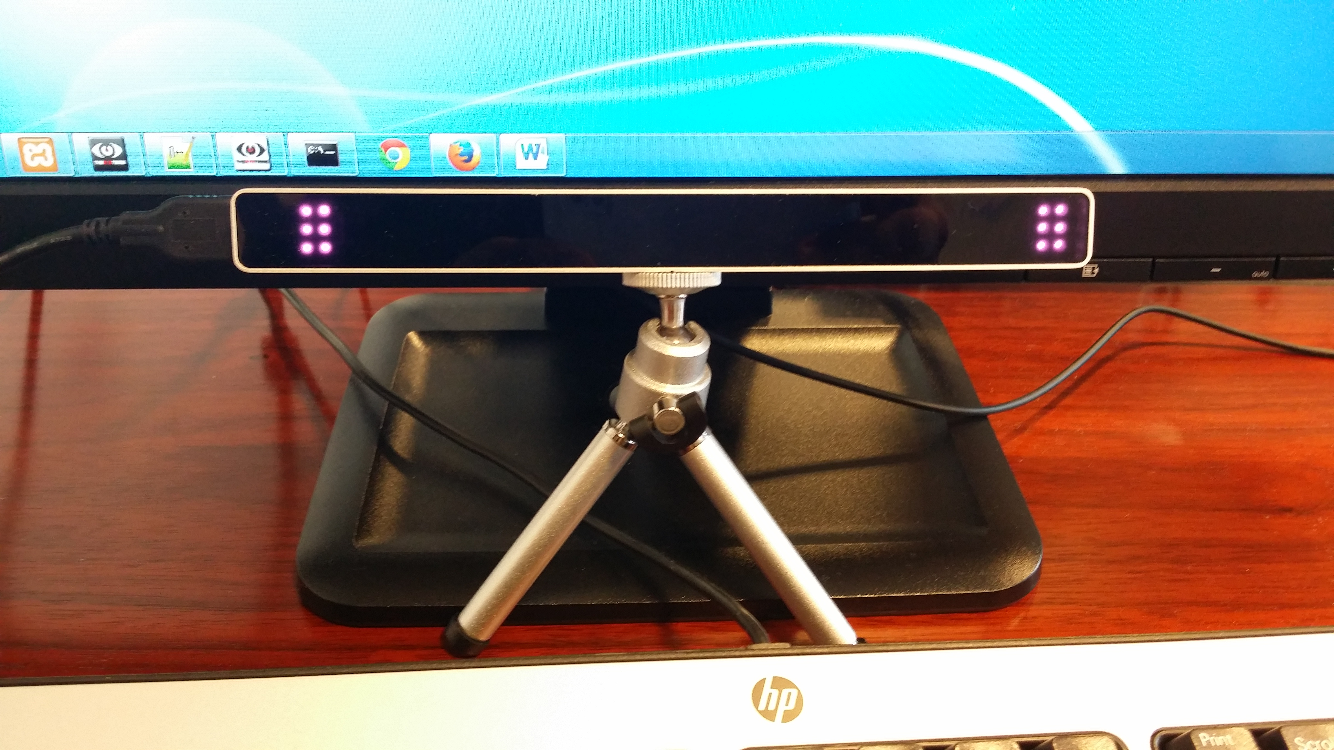
Equipment: Eye-tracker

Slide 4
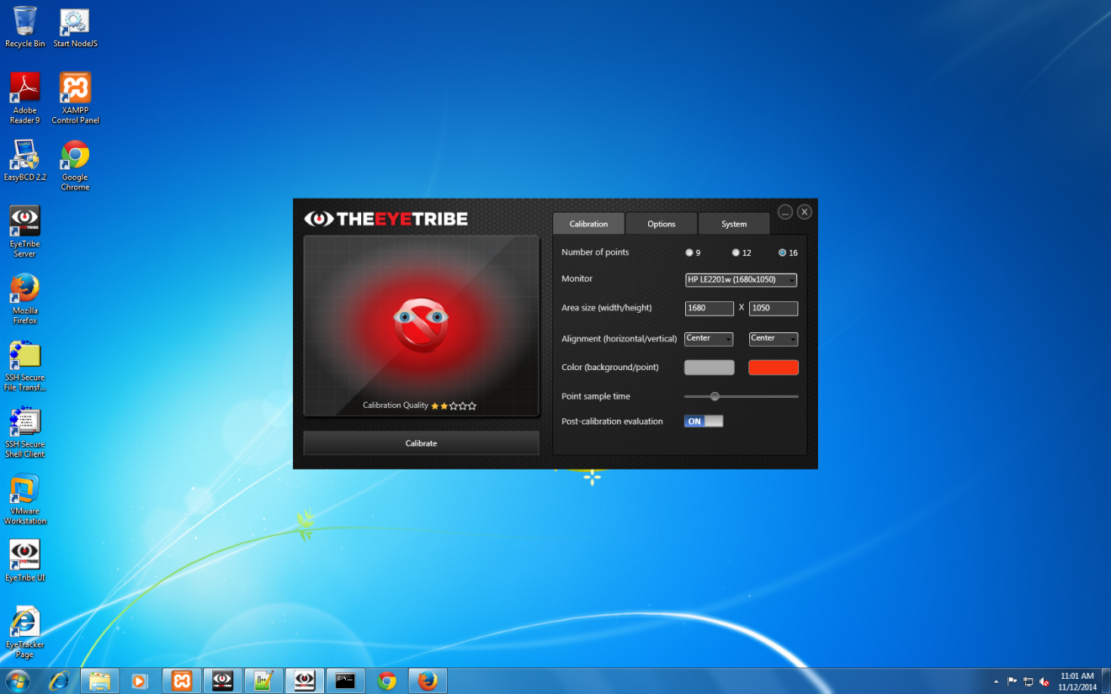
1 Step: Calibrate the eye-tracker: Screen

Slide 5
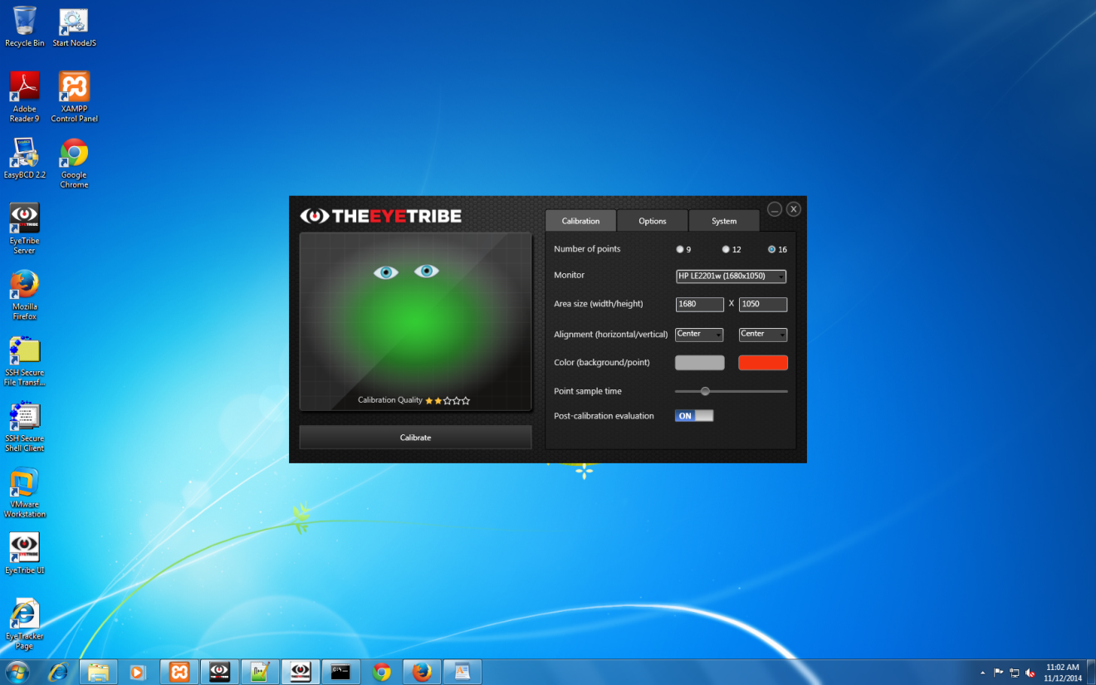
1 Step: Calibrate the eye-tracker: Look with both eyes towards the screen. You need to obtain this:

Slide 6
1 Step: Calibrate the eye-tracker: Press on “Calibrate”

Slide 7

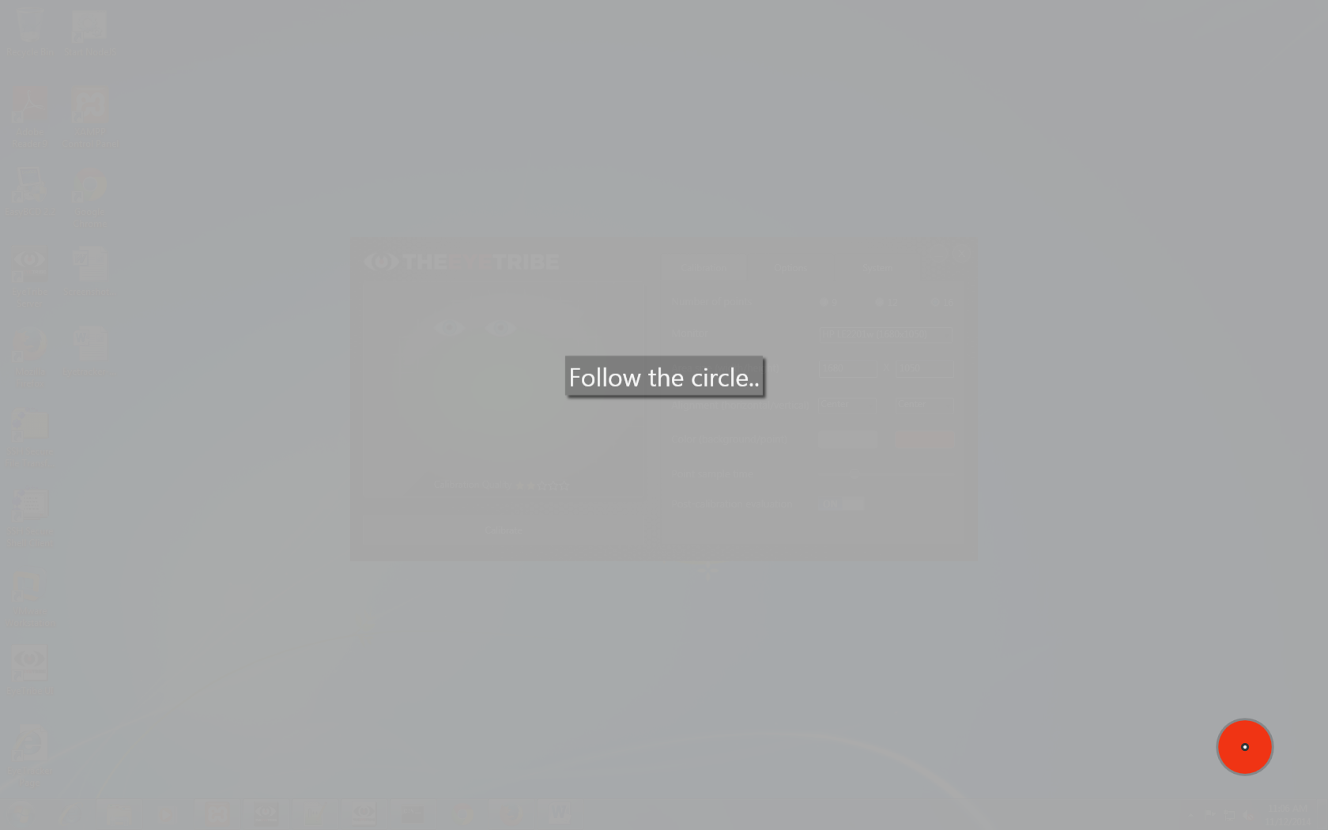
1 Step: Calibrate the eye-tracker: Follow with your eyes the red circle - 1

Slide 8
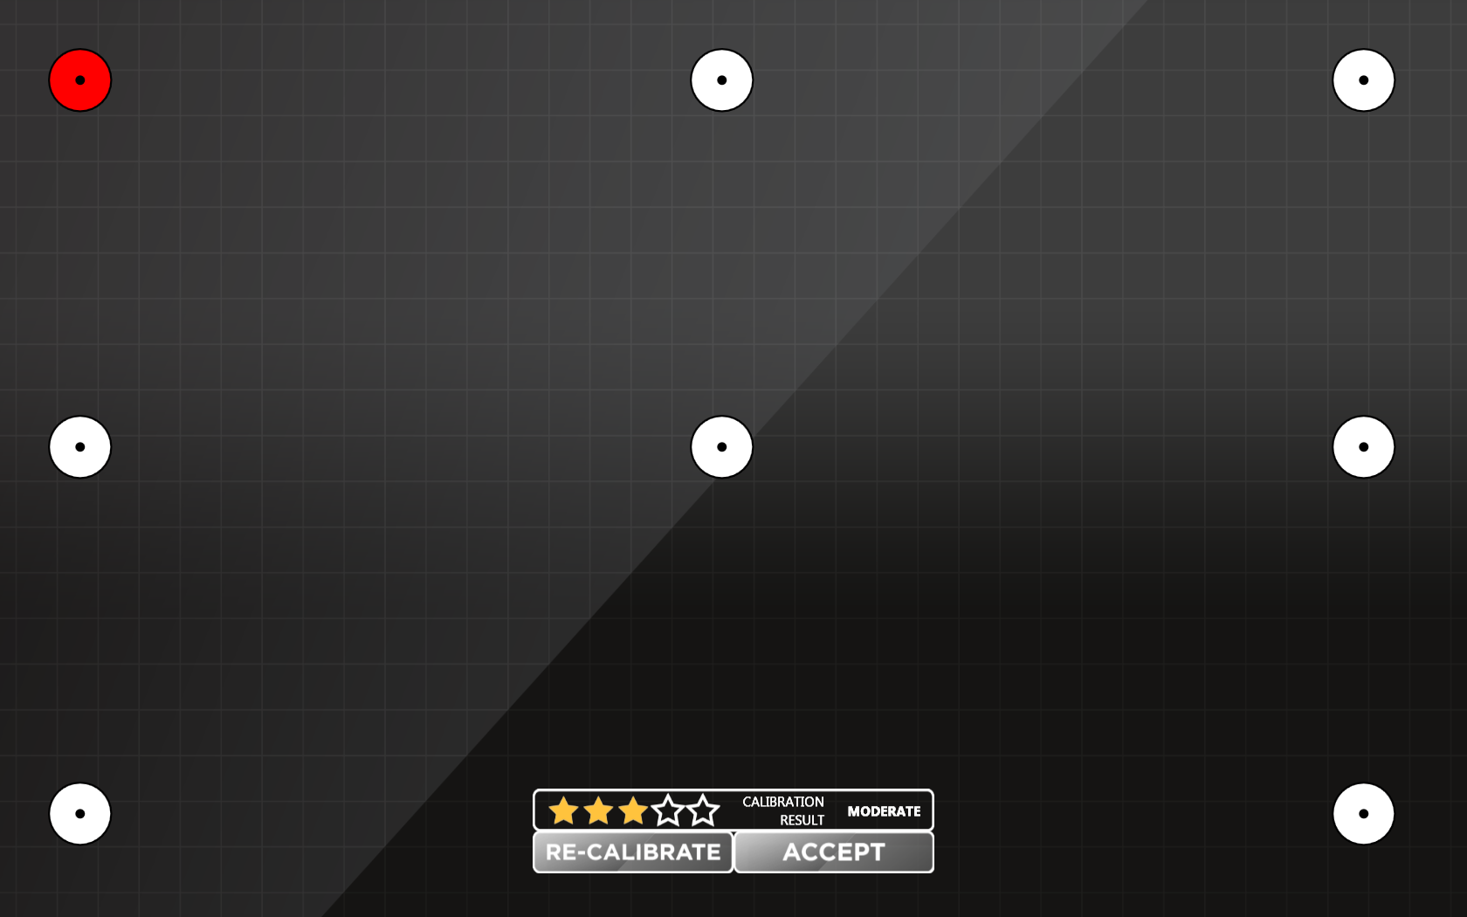
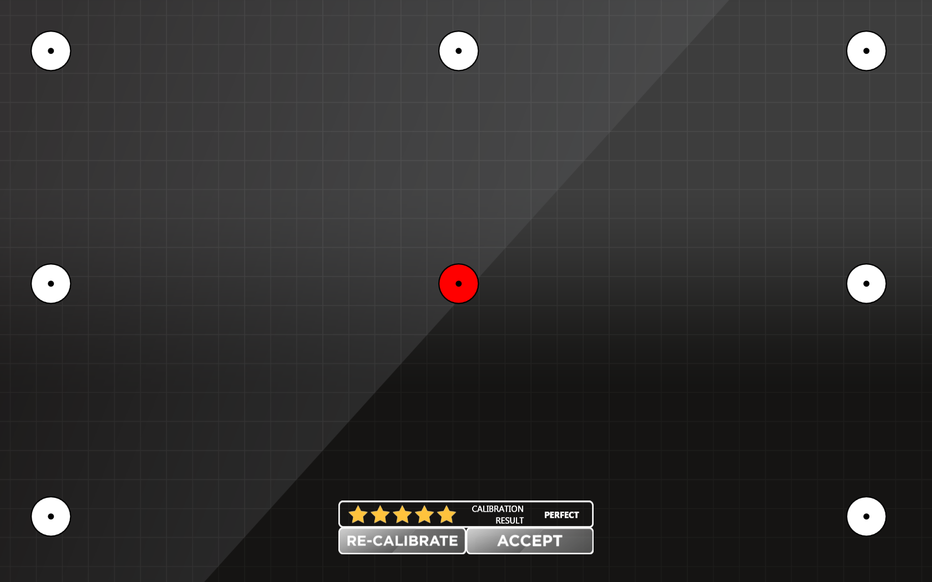
1 Step: Calibrate the eye-tracker: Follow with your eyes the red circle - 2

Slide 9

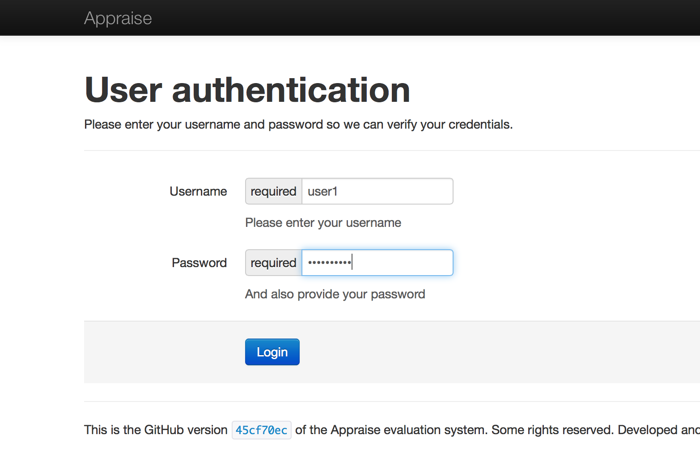
2 Step: User Interface: Log in

